Slide 1

Analysis of tweets on Demonetization
Creators:
Aakash Verma
Ashwin Uday Bhatkal
Divij Asija
under the graceful guidance of Dr Kavitha Sooda.
Word Cloud, Sentiment and Time - series Analyses

Slide 2
Outline
The assignment consists of four major analyses –
Word Cloud – A vibrant pictorial representation of collection of buzzwords among tweets on demonetization in India.
Sentiment Analysis – A positive-vs-negative lexicon analysis of sentiments over demonetization in tweets.
Popularity – A simple sum of retweets and favourite count as a measure of popularity.
Time - series analyses – Comparisons drawn over tweets and retweets with time.

Slide 3
How did we do it?
Retrieval of near real-time tweets using R’s twitteR library.
Sequence of ETL operations on tweets
Development of variables and plots for analyses

Slide 4
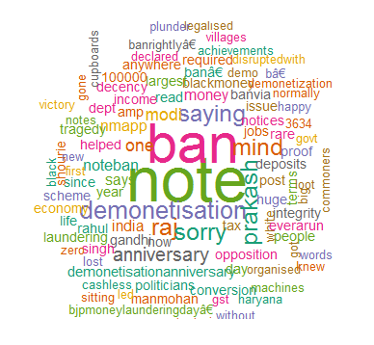
Word Cloud Analysis
A word cloud made out of analysis of demonetization lexicon from about 1500 tweets to determine the buzzwords.

Slide 5
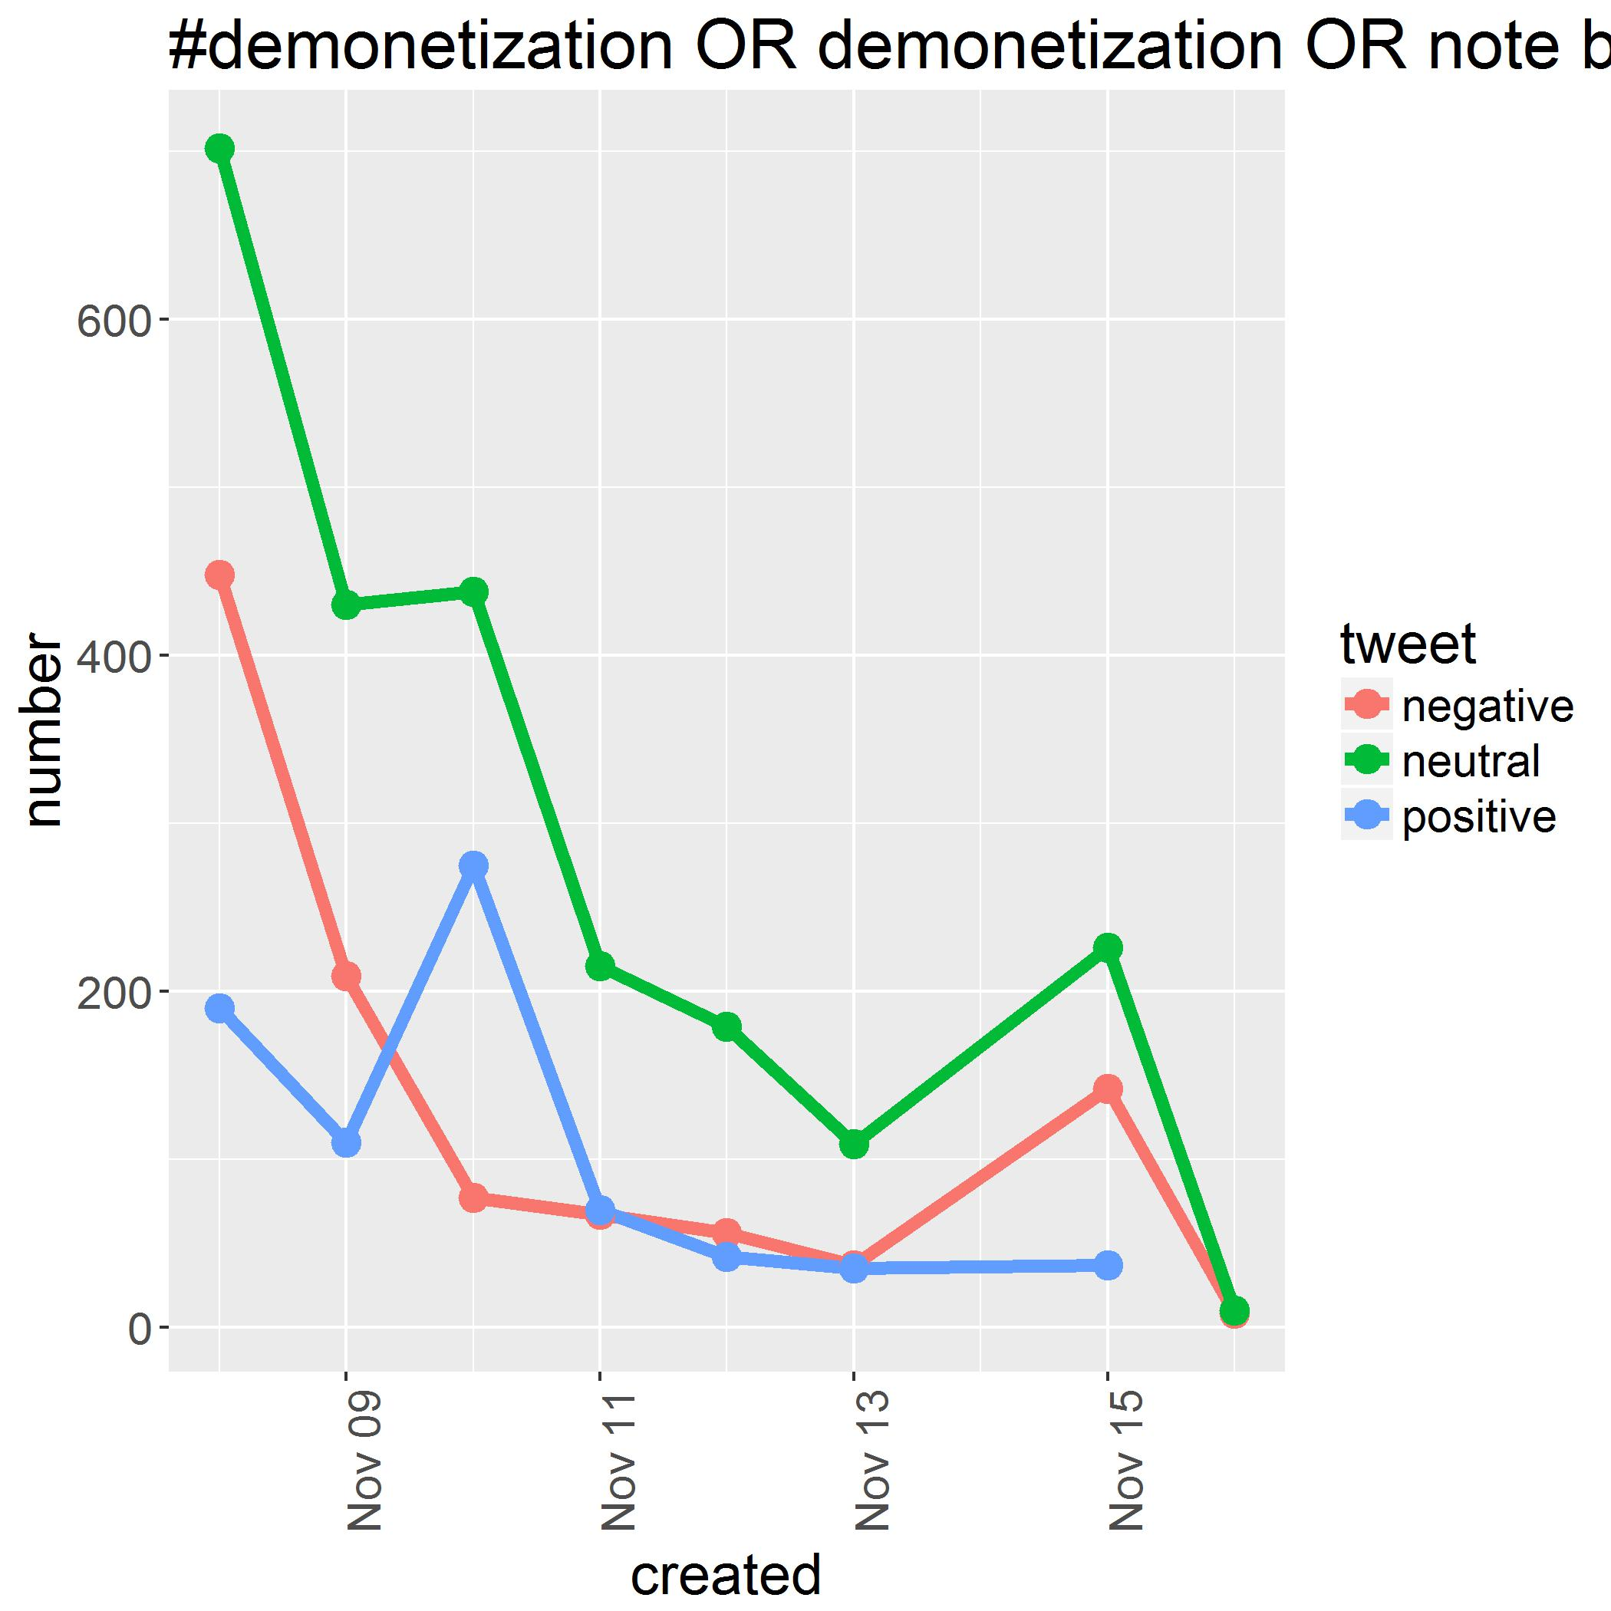
Sentiment Analysis
A simple sentiment analysis of tweets via summative scoring of positive and negative words referencing corresponding lexicons.

Slide 6
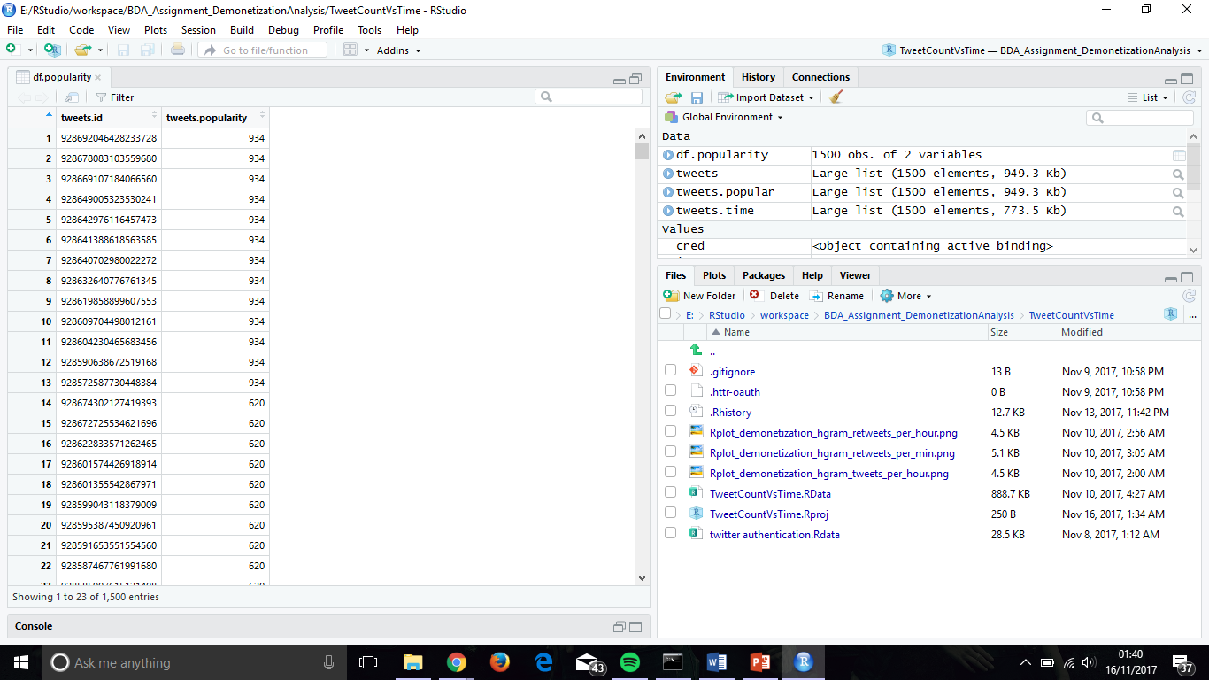
Popularity
A simple reordering of tweets on the basis of the sum over their respective retweet and favorited counts.

Slide 7
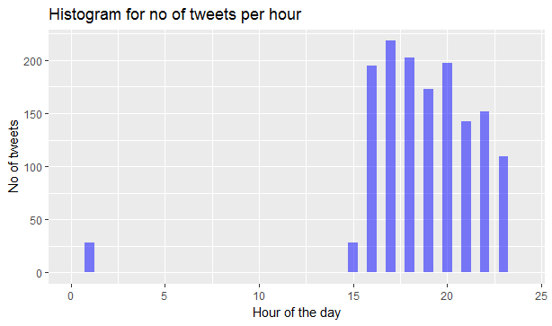
Tweets over Time Time Series Analysis
No of tweets vs hour of the day (00 - 23) over a set of 1500 tweets.

Slide 8
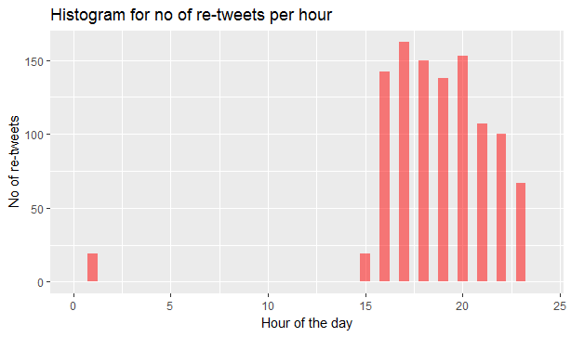
Tweets over Time Time Series Analysis
No of retweets vs hour of the day (00 - 23) over a set of 1500 tweets.

Slide 9
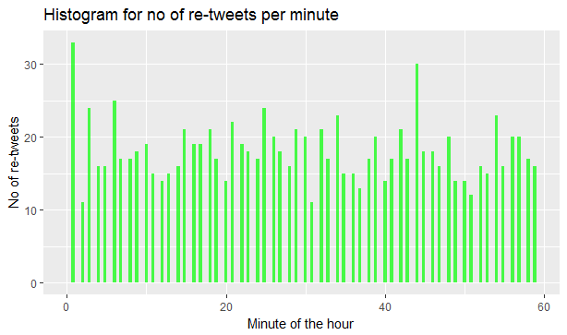
Tweets over Time Time Series Analysis
No of tweets vs minute of the day(00 - 59) over a set of 1500 tweets.

Slide 10
Tools and References
To list, the tools used for the analyses are:
R and RStudio
Twitter Application Management
Libraries used:
twitteR
ROAuth
tm
dplyr
ggplot2
stringr
Web help:
How to create a Word Cloud http://analyticstraining.com/2014/how-to-create-a-word-cloud-in-r/
Sentiment Analysis of tweets https://www.r-bloggers.com/twitter-sentiment-analysis-with-r/

Slide 11
Questions or suggestions?

